Slide 1
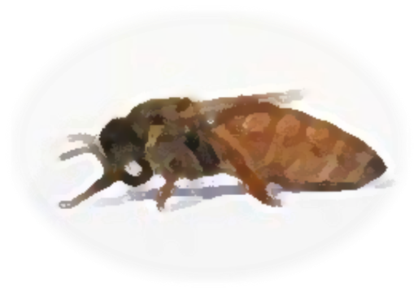
Fresh Harvested Bee Milk
By Beetox
A Cell Based Anti-Aging Diet

Slide 2
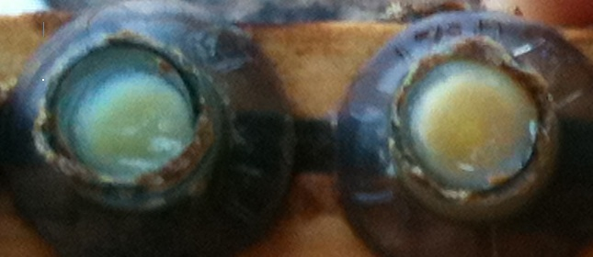
What is Bee Milk?
Bee Milk is also known as royal jelly.
Bee Milk is a nutritionally rich creamy substance produced by the nursing bee. Bee Milk shares the same homeostasis as breast milk and not only serves as the embryonic fluid but also food for the larvae.
Bee Milk is fed to all the larvae for the first 3 days.
For those first 3 days, all the larvae has the same DNA.

Slide 3
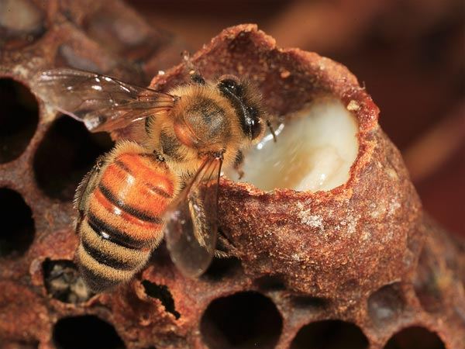
Why the DNA Changes
The larvae’s DNA changes when the diet changes.
After 3 days, only the larvae selected to become queens are fed Bee Milk after the third day. The larvae in the cells filled with Bee Milk develop into queens.

Slide 4
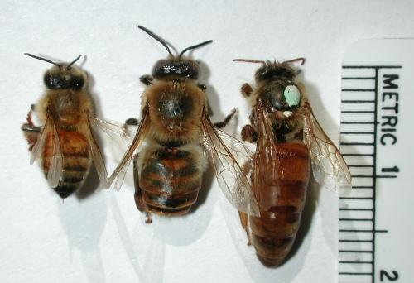
Biological Differences
This change in DNA triggers profound biological changes for these future queens.
They develop reproductive organs, live longer and are larger than the worker bees. The worker bees live 35-40 days; the queen can live up to 6 years.
Worker
Queen
Drone

Slide 5
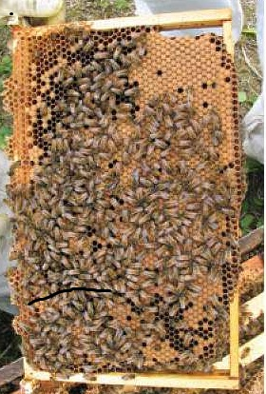
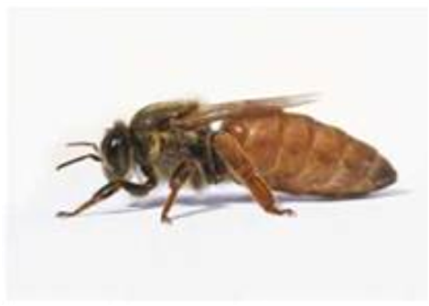
Because of her diet of Bee Milk
The queen is the only honeybee in the hive capable of laying fertile eggs.
During her extended life span, she lays up to 1 ½ million eggs.

Slide 6
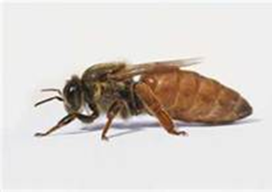
The queen’s remarkable strength, vitality, resilience and longevity is explained by just one single factor…
Her anti-aging cell based diet! Bee Milk is the only food the queen consumes during her entire life.

Slide 7
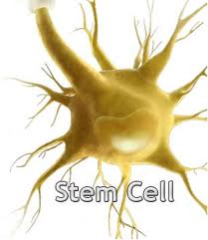
What is an Anti-Aging Cell Based Diet?
Regenerative Medicine

Slide 8
An anti-aging Cell Based Diet = “Regenerative Medicine”.
“Regenerative Medicine” came from Bill Haseltine one of the early leaders in DNA technology. Since the 1990s, his research on anti-aging is making important advances on turning back the clock of aging in human cells by utilizing stem cells and their derivatives to regenerate or repair all the tissues of the aging human body.
Basically regenerative medicine helps to reverse cellular aging.
Immortal Stem Cells for Anti-Aging Therapies, Michael D. West, PhD, Life Extension, June 2010

Slide 9
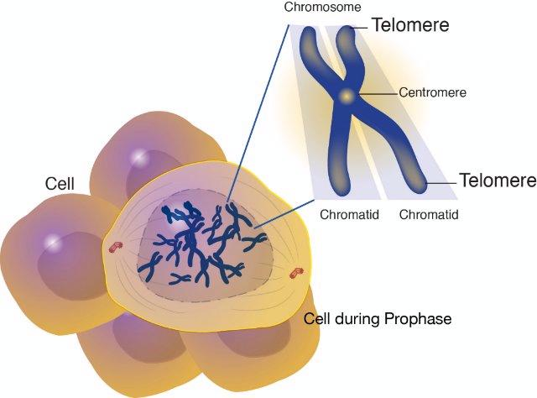
Telomeres
As we grow older, our cells age, and the telomeres found inside the cells get shorter. Telomeres are the molecular clock of our cells and every time a cell divides they get shorter. Stress, poor diet, and obesity reduces the length. When these telomeres become shorter, there is less telomerase activity in the cell.
Telomerase activity is a critical anti-aging enzyme needed to ward of aging and cell renewal.
Immortal Stem Cells for Anti-Aging
Therapies, Michael D. West, PhD,
Life Extension, June 2010

Slide 10
video
http://www.youtube.com/watch?v=8vm29Zn8vXE

Slide 11
Telomerase
. Decreased telomerase activity means increased signs of aging. We start to lose our energy, feel weaker, wrinkles appear, and we develop age related diseases because our bodies don’t have the same ability to regenerate or repair cells.
Immortal Stem Cells for Anti-Aging Therapies, Michael D. West, PhD, Life Extension, June 2010

Slide 12
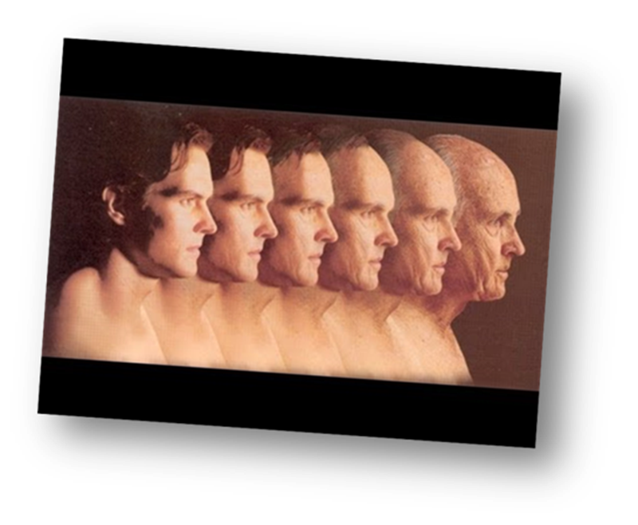
Anti-Aging
The goal of anti-aging research has been to discover ways to reverse aging by transferring stem cells into the body, and preserve telomeres to increase life span, improve overall health, and prevent disease. Scientists believe Bee Milk is filled with potent antioxidants and its cell based properties help sustain telomerase activity to tune down aging.
Immortal Stem Cells for Anti-Aging Therapies, Michael D. West, PhD, Life Extension, June 2010
Gerontol. 2007 Jul;42(7):594-600. Epub 2007 Feb 20. University of Ljubljana, Biotechnical Faculty, Food Science and Technology Department, Chair of Biotechnology

Slide 13
Bee Milk=Supports Telomeres
In 2003, a study by the Russian Academy of Medical Sciences found Bee Milk is loaded with peptides that stimulate telomerase activity.
St. Petersburg Institute of Bio-regulation and Gerontology, North-Western Division of Russian Academy of Medical Sciences, 2003.

Slide 14
Bee Milk: Stem Cells
Keep in mind, Stem Cells serve as a sort of internal repair system, capable of replicating, dividing, renewing essentially without limit to replenish other cells in the body. These cells “generate replacements for cells damaged or lost through normal aging, wear and tear, injury, or disease”.
Source: In Stem Cell Information, World Wide Web. Bethesda, MD: National Institutes of Health, U.S. Department of Health and Human Services, 2009 [cited Wednesday, October 17, 2012

Slide 15
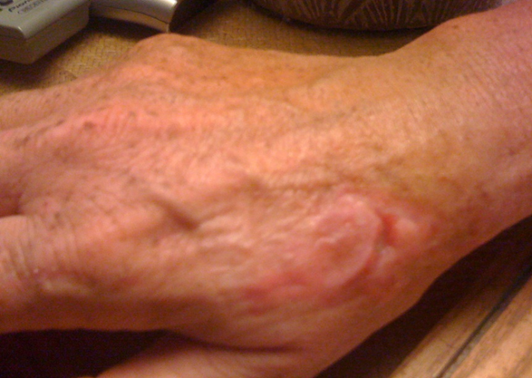
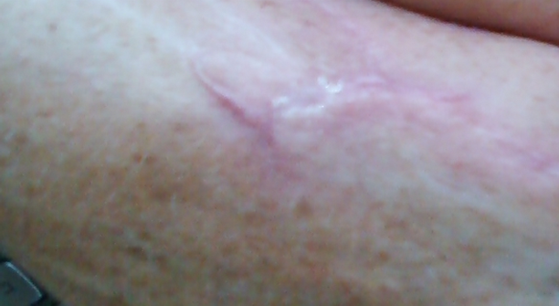
2 weeks later
One week later
Dog Bite
Royal Jelly:
Stem Cell Based Therapy

Slide 16
Bee Milk
Alternative Medicine
Skin Care
Nutritional Supplement
Notes:
Refer to socialization article, cell damage inflammation and clogging

Slide 17
Fresh Bee Milk “Regenerative and Preventive”
Helps Improve Cellular Health
Helps Prevent Disease
Anti-aging Properties

Slide 18
Fresh Bee Milk
Delivers Antioxidant Support
Helps regenerates cells
and Supports Telomeres

Slide 19
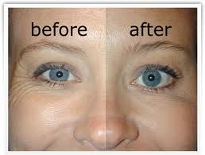
It is an undisputed scientific fact that disease prevention, health, healing, beauty, and anti-aging all begin at the cellular level.

Slide 20
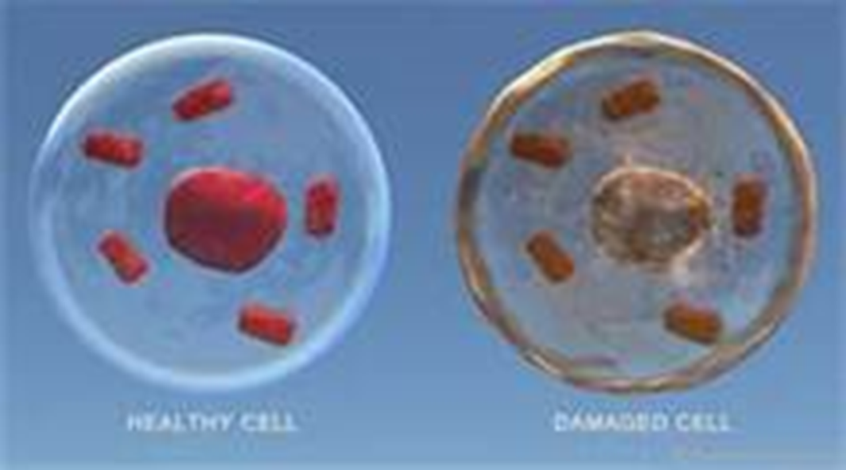
Because we have trillions of cells
There are 50-100 trillion cells estimated in the human body. There is no way to know exact number. The cells in your body are not static, always changing, many variables, your size, health condition, etc.

Slide 21
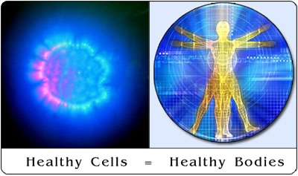
We need to take care of them!
Cells need a clean environment, the right pH, oxygen and essential nutrients to survive. Bee Milk is one of those essential nutrients!

Slide 22
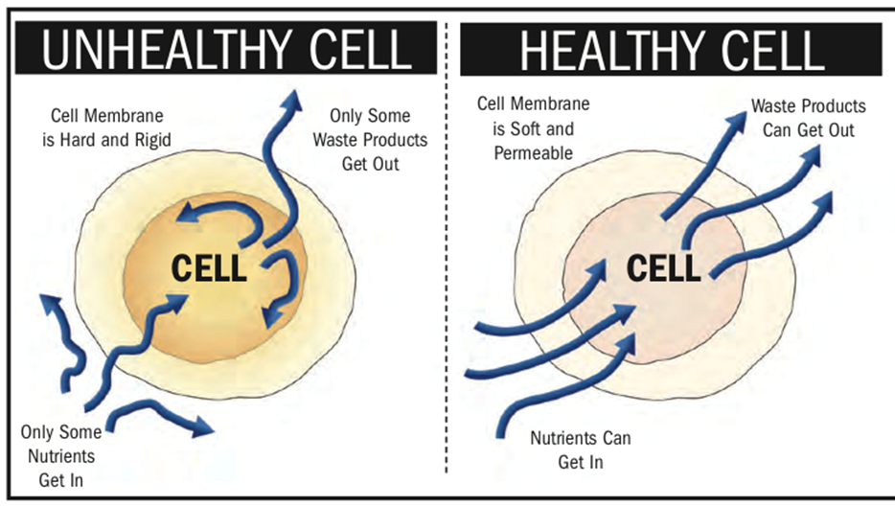
Scientists do know
Disease is a result of cell damage, free
radicals, depleted oxygen and pH
imbalance.

Slide 23
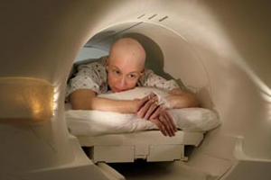
Joseph Issels and Otto Warburg, pioneers in cancer research firmly believed there was a direct relationship between pH and oxygen levels, weakening immune system and cancer cells.

Slide 24
Potent Antioxidant
Bee Milk acts as a scavenger to the cell, which has been shown in laboratory studies to remove free radicals, restore PH and oxygen levels, and provides essential nutrients to the improve efficiency.
Gerontol. 2007 Jul;42(7):594-600. Epub 2007 Feb 20. University of Ljubljana, Biotechnical Faculty, Food Science and Technology Department, Chair of Biotechnology

Slide 25
Results from a 2007 study
Found Bee Milk decreases intracellular oxidation…affects growth and cell energy metabolic activity…and affects protein expression.
Bee Milk also helps protect against oxidative stress-induced cell death in human cultured cells.
Sources: Exp Gerontol. 2007 Jul;42(7):594-600. Epub 2007 Feb 20. University of Ljubljana, Biotechnical Faculty, Food Science and Technology Department, Chair of Biotechnology; Chen HM, Muramoto K, Yamauchi F. Food Science and Technology Research [2005, 11(2):222-230]

Slide 26
Bee Milk is Beneficial
For Honeybees and Humans

Slide 27
Bee Brainy Again
The National Geographic wrote an article on July 10, 2012, on anti-aging that may help humans lead longer, better lives. Research published in the journal Experimental Gerontology, shows that aging honeybees can regain the brainpower of youth.
This bee study looked at the different capabilities of young and old members in a colony.

Slide 28
Got their old job back
Researchers removed the young, "nurser" bees from the hive and replaced them with older bees which had exhibited "age-associated learning deficits" toward the end of their six-week life expectancy.
They took on the nursing responsibilities that they had fulfilled earlier in life, for example secreting “bee milk" for larvae.

Slide 29
Young Again
The research led by Nicholas Baker of the Arizona State University School of Life Sciences reported that many of the older bees "were performing as well as the young “nurser bees” had.
They're intelligent again! So what happened?“
They started producing and secreting Bee Milk from their glands again...that’s what happened!

Slide 30
Bee Milk=Regenerates Cells
According to a study in 2008 by the Department of Biofunctional Analysis, Bee Milk has stimulatory effects on the generation of cells and promotes neurogenesis, the development of new brain cells, also increases levels of acetylcholine. Bee Milk is known to be a natural source of acetylcholine.
3.Shoei Furukawa in 2008 at the Laboratory of Molecular Biology, Department of Biofunctional Analysis, Gifu Pharmaceutical

Slide 31
Evidenced Based Research
Bee Milk helps to improve:
Heart health and cardiovascular function
Brain health
Enhanced Immunity
Joint health
Antioxidant support
Telomerase activity
Regulate Hormones men and women
Journal of Apicultural Research, 2004 41 (3-4) 75-82
Bull Exp Biol Med. 2003 Jun;135(6):590-2.
Biomedical Research, 2011 22 (1): 1-8
Royal Jelly and neural regeneration, Brad Weeks, MD, 2-7-2009

Slide 32
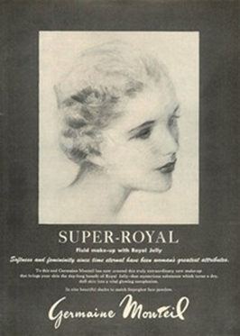
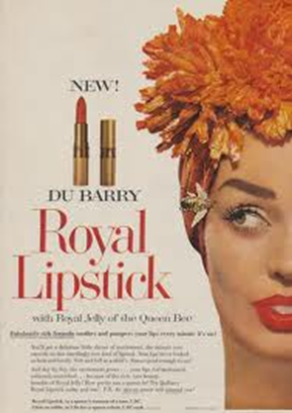
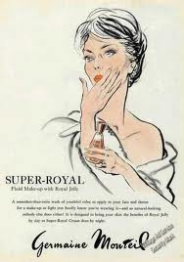
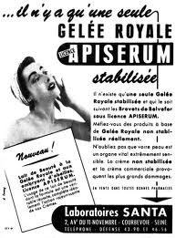
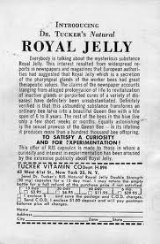
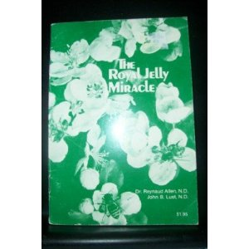
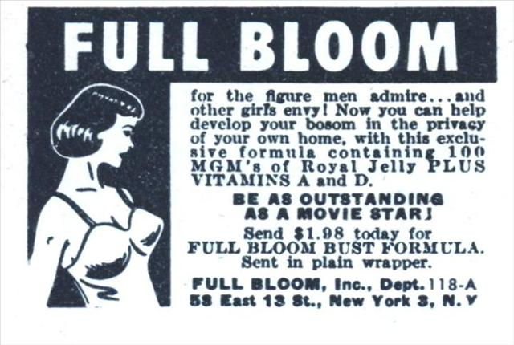
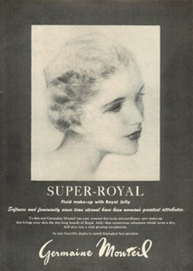
The healing wonders is old news

Slide 33
Throughout History
Egyptians believes Bee Milk wards off aging.
Mayans called it the “fountain of youth”.
Orientals used Bee Milk in medicines for centuries.
Hippocrates wrote it is a “medicine for several ailments”
Aristotle wrote of its benefits, and the Greeks used it in a health elixir.
Bee Milk is referenced in Bible, Koran &Talmud.

Slide 34
Few Bee Milk Enthusiasts
Cleopatra 89BC (skin care)
Alexander the Great 336 BC (nutrition)
Marco Polo 1200-1300 (nutrition)
Pope Pius XII 1950’s (alternative medicine)
Princess Diana (1980’s) (skin care and alternative medicine)
These are just a few who used Bee Milk!

Slide 35
Not all Bee Milk is
Effective

Slide 36
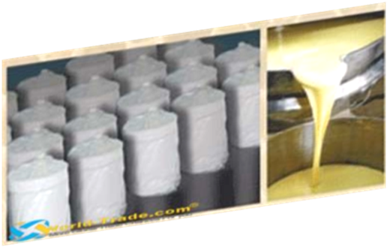
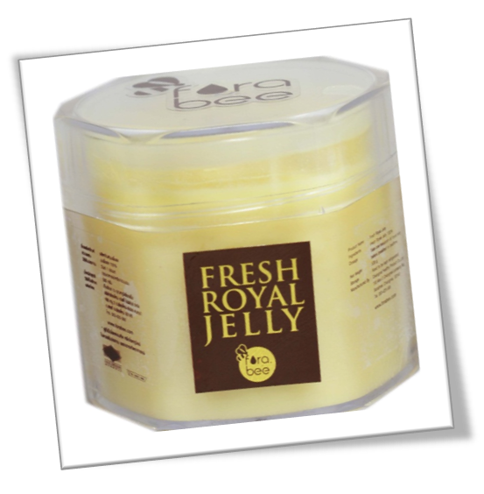
Some has been
1. Altered
2. Manufactured
3. Compromised

Slide 37
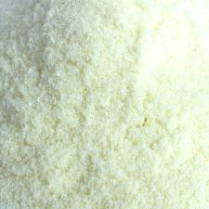
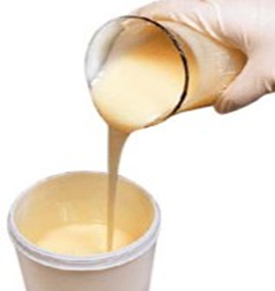
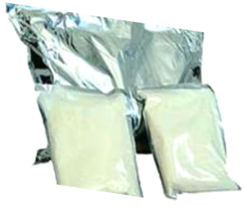
Altered
Bee Milk that has been heated, freeze dried, and or filled with preservatives may not be effective.

Slide 38
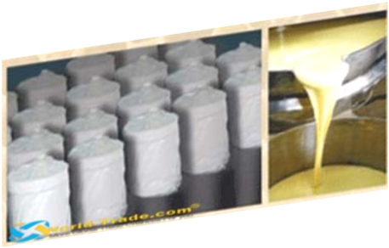
“Manufactured”
Bee Milk that has been manufactured in labs
Synthetic vs. natural
Manmade vs. beemade!
May not be effective

Slide 39
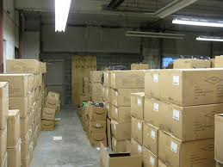
Compromised
Bee Milk may be compromised due to exposure to varied temperatures, metals or contaminants during the packing and shipping which could also effect the properties.
Richard Allen of The Evening Standard, wrote “Chinese medicines have been found to contain dangerous and illegal ingredients…could contain high levels of antibiotics”, 2012.

Slide 40
Scientists are not able duplicate RJ
Bee Milk continues to be an enigma…like honey scientists are unable to replicate…
Because they are unable to identify all the properties or completely break down all the components due to a “missing intrinsic factor” therefore unable to “duplicate its effect “.
Source: The Royal Jelly Miracle, published 1958

Slide 41
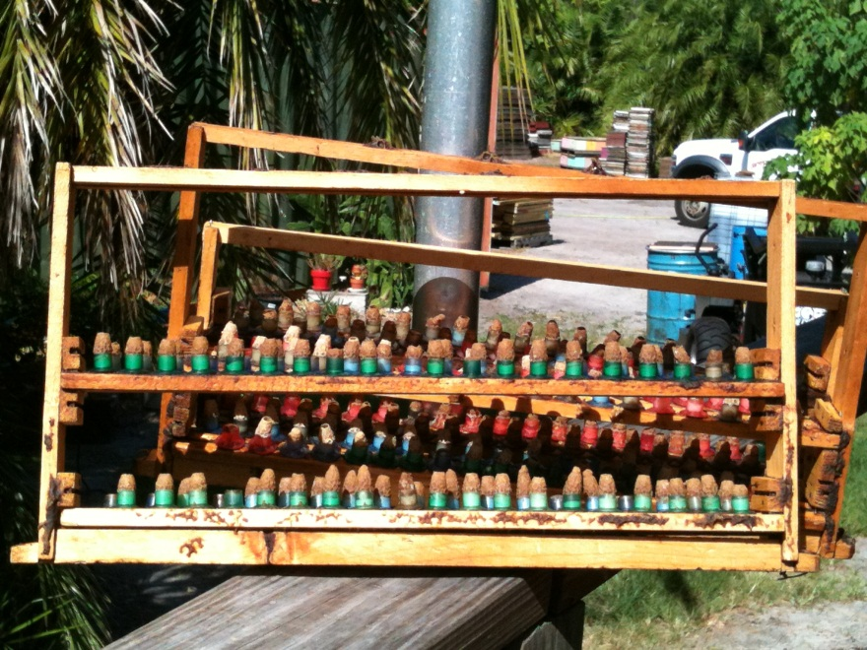
Why is there limited supply of fresh harvested Bee Milk
Harvesting Bee Milkis labor intensive
You collect minuscule amounts
Costly to produce

Slide 42
How we Produce RJ
Port Saint Lucie, Florida

Slide 43
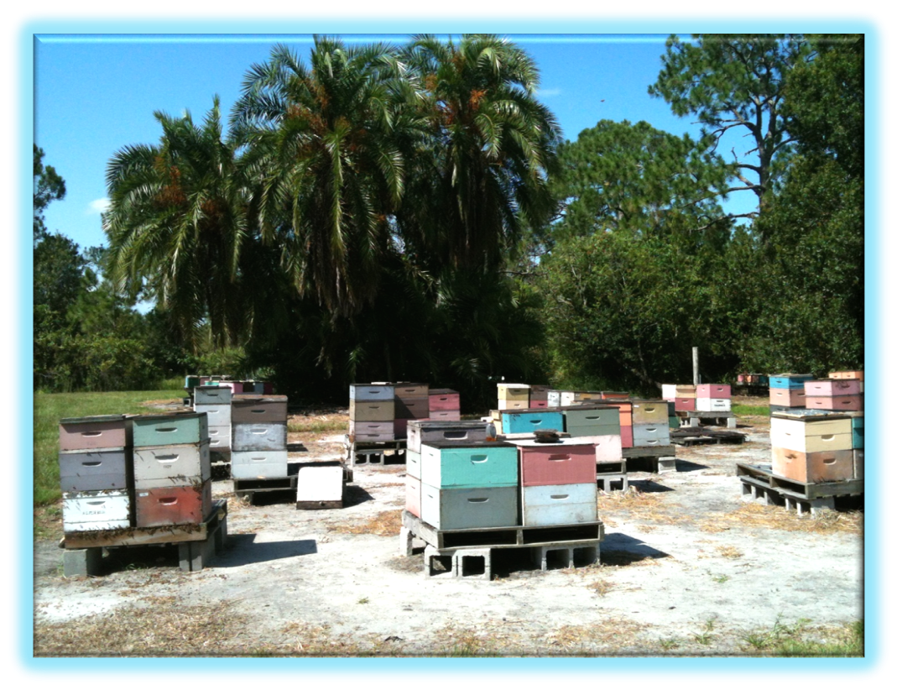
Queen Yard

Slide 44
1.First we prepare starter hive in the AM

Slide 45
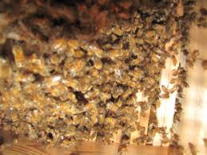
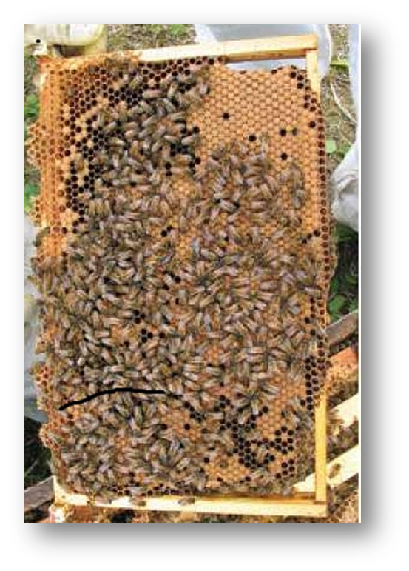
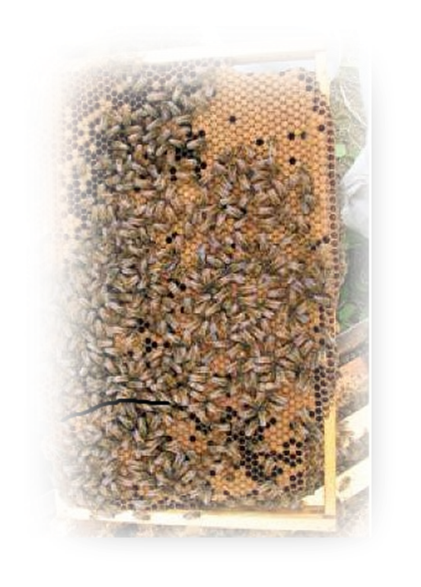
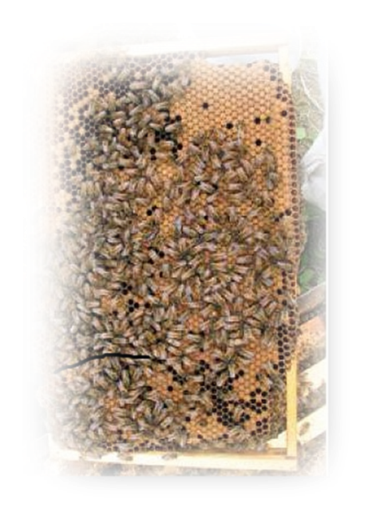
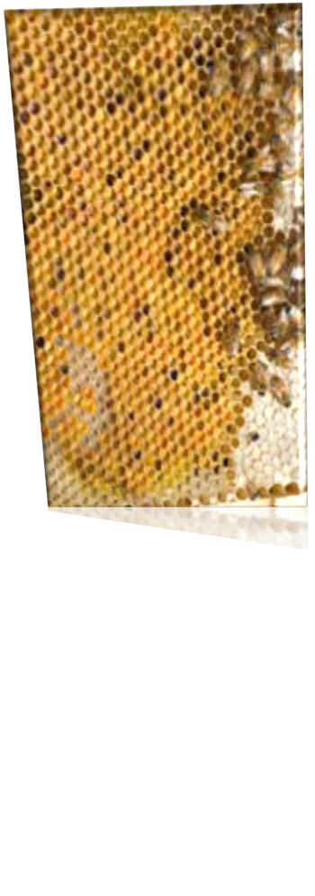
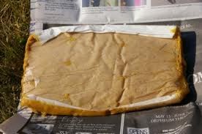
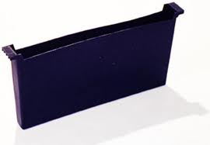
How we make a Starter
6 Frames of Capped Brood
Lots of young bees
1 Pollen Patty
1 gallon Feeder
1 frame of
pollen

Slide 46
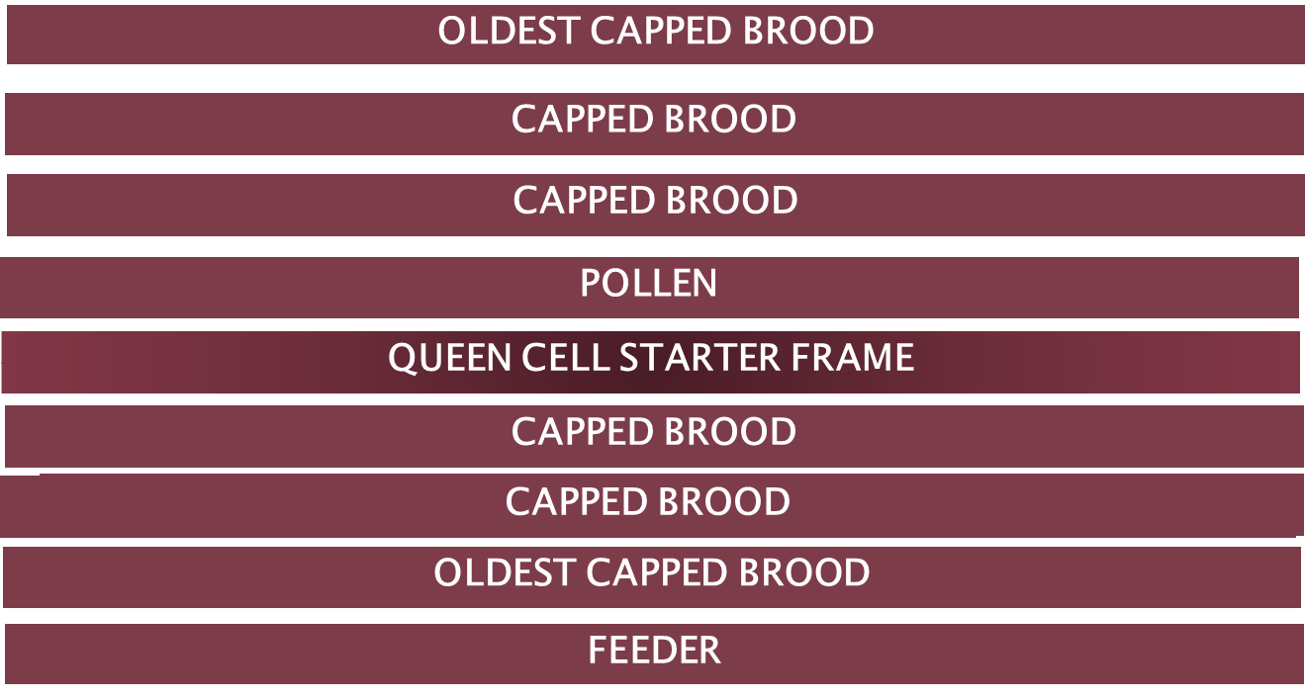

Slide 47
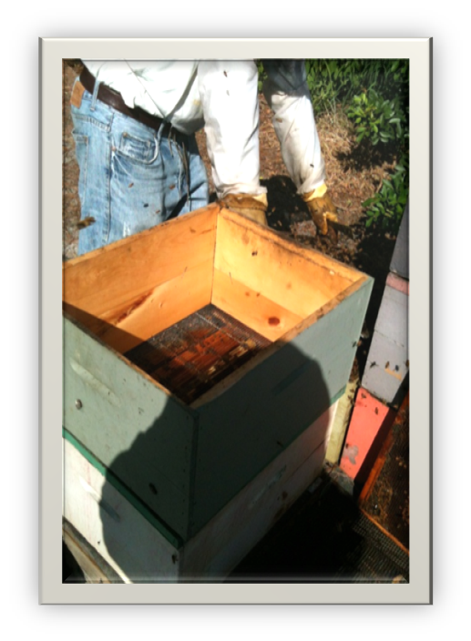
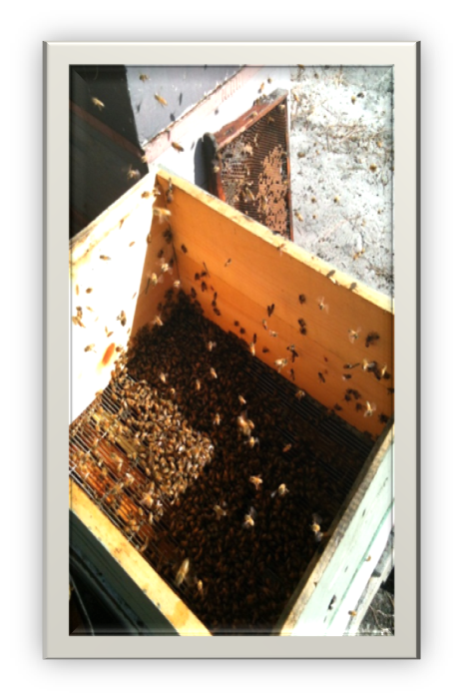
Starter

Slide 48
2. Then we graft the cells in the PM

Slide 49
Grafting Tips
Good eyesight is helpful
Transfer one day old larvae into the artificial queen cups.
Avoid damaging them with the grafting tool.
Do not let the larvae dry out. Keep a damp towel on hand.

Slide 50
Steps to Grafting
Prime cell cups with “real” Bee Milk
Obtain 1 or 2 frames of brood for sufficient supply of 1 day old larvae
Comfortable seating and good light source so you can see the bottom of the cells in search of the youngest larvae
Do not submerge larvae or scrape off as you may kill them

Slide 51
3. Next, we place graft in finisher hive for 2 days

Slide 52
4. After 2 days we remove frames

Slide 53
5. Immediately scrape wax off the cell

Slide 54
6. Remove larvae

Slide 55
7. Vacuum RJ into a large syringe

Slide 56
8. Insert into oral syringes

Slide 57
Then the Bee Milk is
Sealed
Dated
And placed in the freezer to preserve integrity.

Slide 58
How do you use RJ?
Our RJ is sold in 1 ml and 1.25 ml oral syringes ( a 5 to 10 day dose per ml). You need to keep refrigerated.
oral use:
Place 100-200 mg under tongue on empty stomach.
Or insert one syringe into 4-6 ounces of honey and take one teaspoon daily (does not need to be refrigerated).
For skin care:
Apply concentrated directly on affected areas, sparingly.
Or Mix 1 ml syringe into 4 to 6 ounce jar all natural moisturizer and store in refrigerator. Use daily.

Slide 59
Customer’s Testimonials
Periodontal tooth abscess problems
acne, rash, and skin problems
Improves immune system
Increase sex drive and performance
Increases energy, improves mood
Reduces anxiety, hypertension and cholesterol
Helps thyroid disease, diabetes
Reduces symptoms of Lyme Disease, COPD, allergies, digestive issues, colitis, IBS
Improves cognition, memory, …

Slide 60
Nothing Better in Life
When our customers begin to undergo changes, they :
Look and feel younger and healthier
Regain their strength, become more energized.

Slide 61
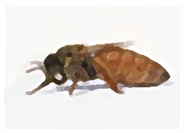
Beetox.com
Contact information:
561-800-4941 office 772-284-0033 cell
Queen Bee Farm Location : 11354 Carlton Road, Port Saint Lucie, FL 34987

